Slide 1
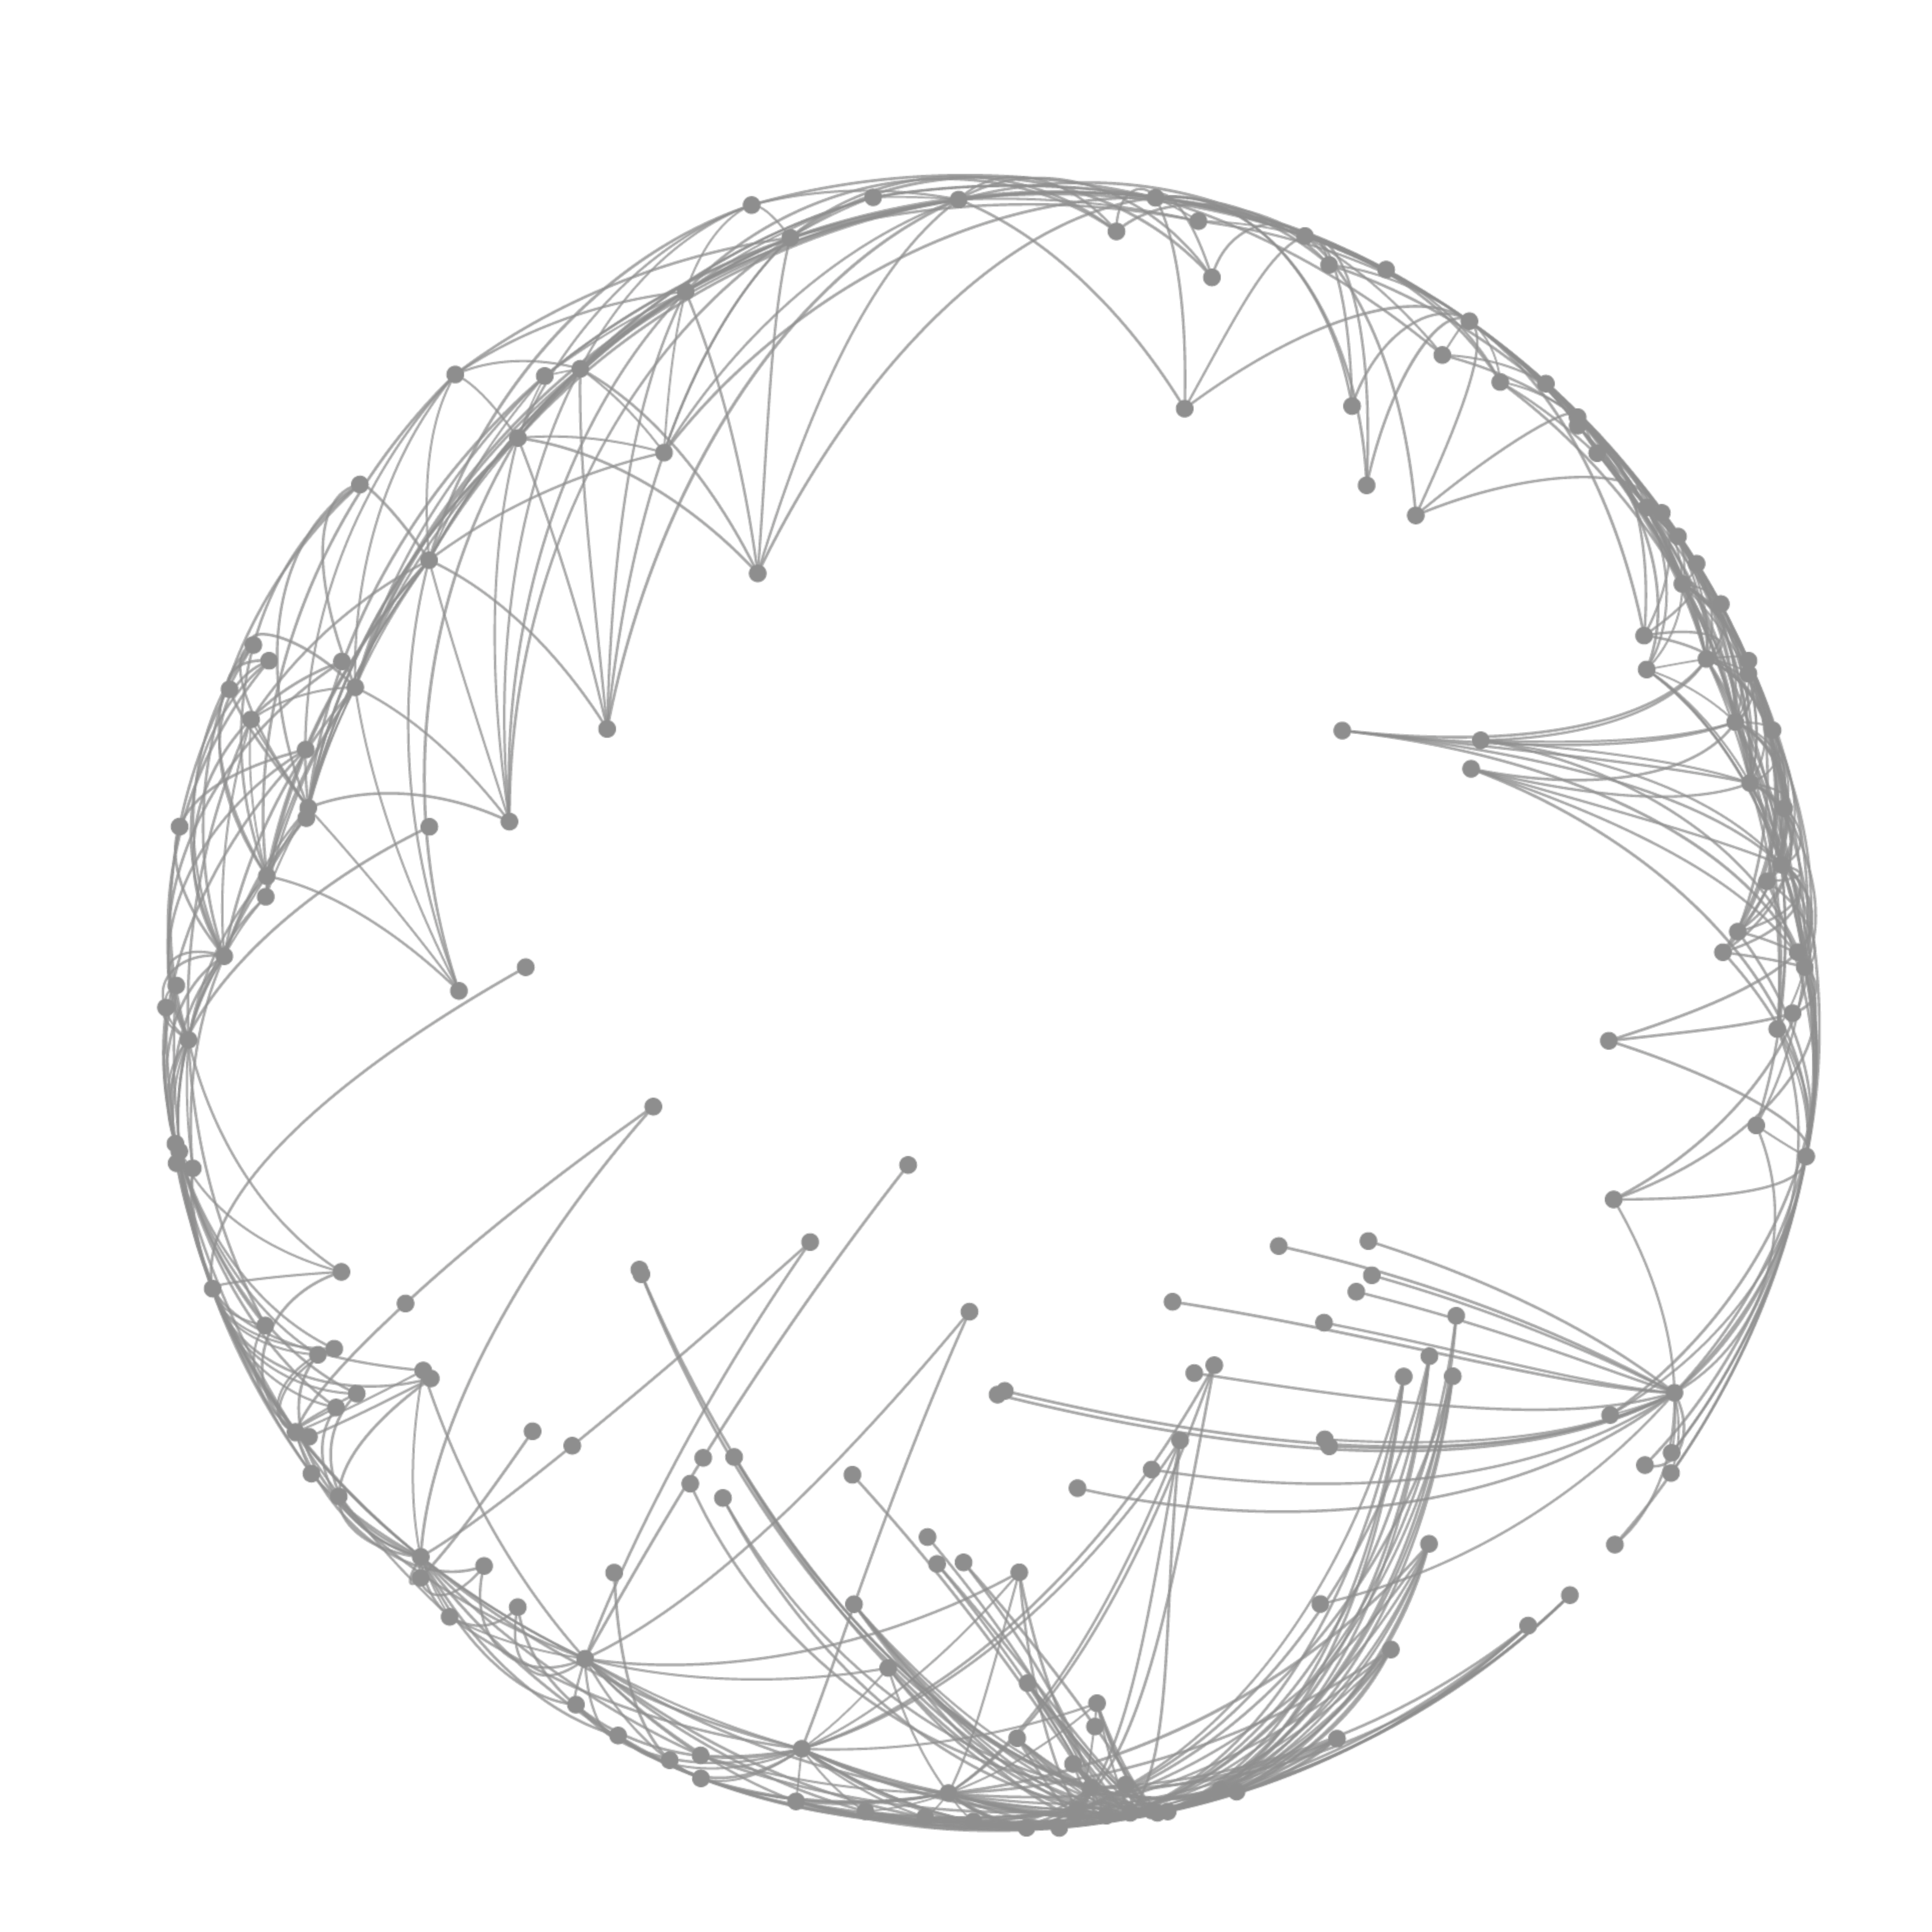

Identify opportunities to improve
NYC Taxi revenue or cut costs
Presented by Roberto Espinoza

Slide 2
1
Introduction
2
Exploratory Analysis
Agenda
3
Open questions
4
Optional questions

Slide 3
1
Introduction
Agenda

Slide 4
Challenges
Build a reliable pipeline
Characterize and model main variables
Uncover insights to boost revenue and/or reduce costs
?
Identify improvement opportunities to support NYC taxi
?
Present an exploratory data analysis
Value Proposition
?
Answer open questions

Slide 5
1
Introduction
2
Exploratory Analysis
Agenda

Slide 6

OVERVIEW

Slide 7
Dataset Highlights
Cover the 2013 annual operation of taxis in New York
48.62 GB
Fares and cost
June
2013
33181
Drivers
13 M
Trips
Fare amount
Surcharge
Tips
Mobility tax
Tolls cost
Transformed to parquet to easily handle it.
30 days of operation
No public holidays
13359 taxis
23.075.014 passengers

Slide 8
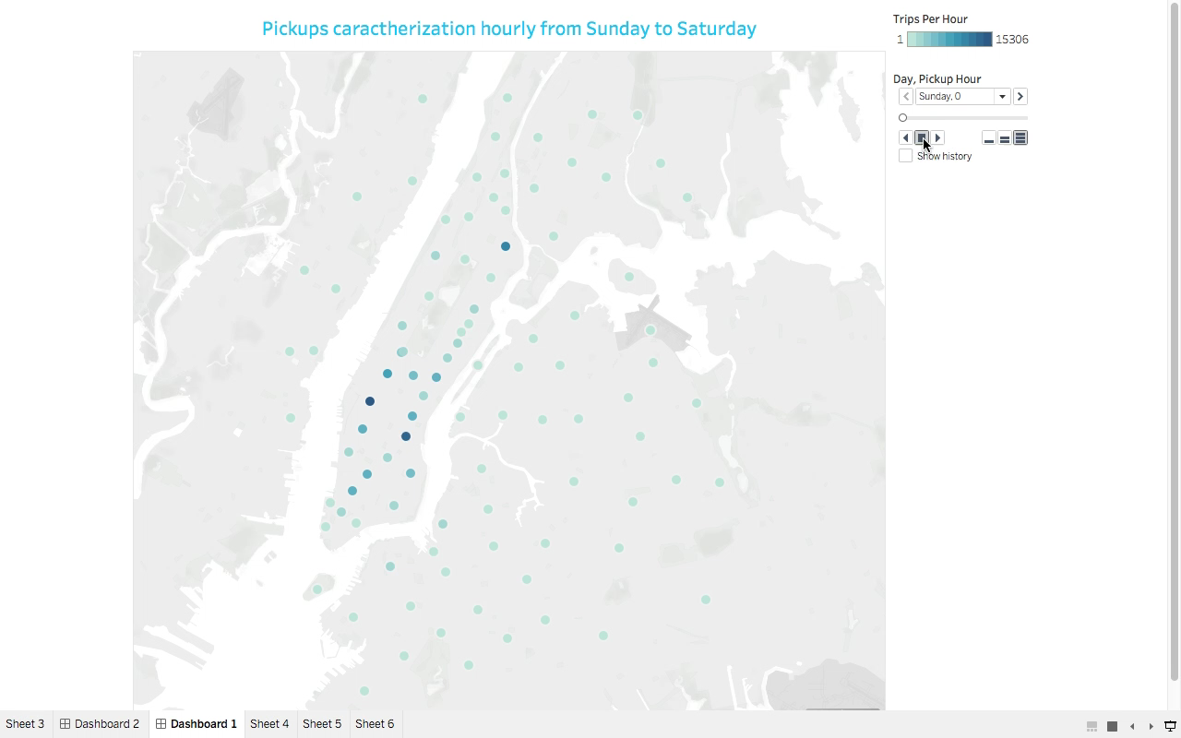
48.62 GB
2 datasets
CONTEXT
360M
Taxi Trips
NYC 2013

Slide 9
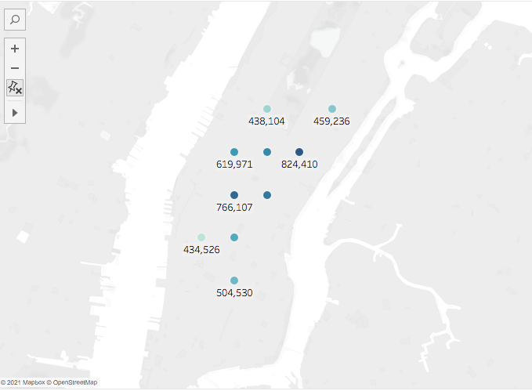
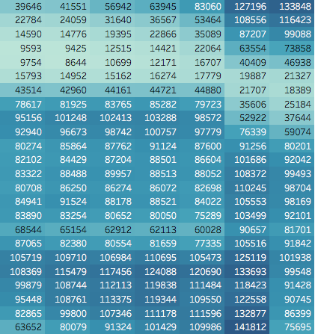
TOP 10 BUSIEST LOCATIONS
BUSIEST HOURS
Monday
Tuesday
Wednesday
Thursday
Friday
Saturday
Sunday
0
1
2
3
4
AM
5
6
7
8
9
10
11
12
1
2
PM
3
4
5
6
7
8
9
10
11

Slide 10
Organic Revenue Growth
Cash
Payment type
Credit card
Passengers per trip
Free Cash Flow

Slide 11
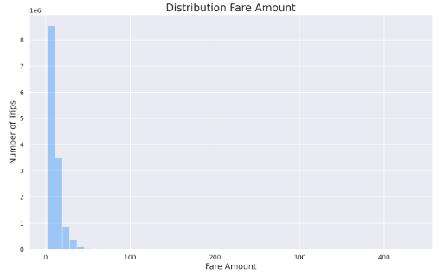
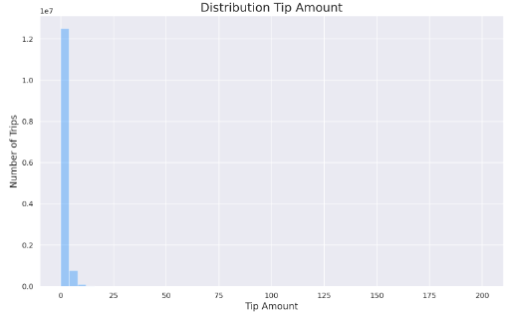
Organic Revenue Growth
Cash
Payment type
Credit card
Passengers per trip
Free Cash Flow

Slide 12
Average trip time by hour
Organic Revenue Growth
Average trip distance by hour
Free Cash Flow

Slide 13
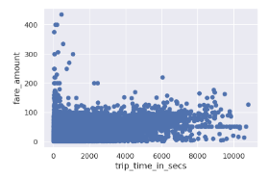
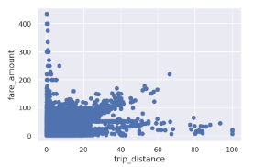
Average trip time by hour
Organic Revenue Growth
Average trip distance by hour
Free Cash Flow

Slide 14
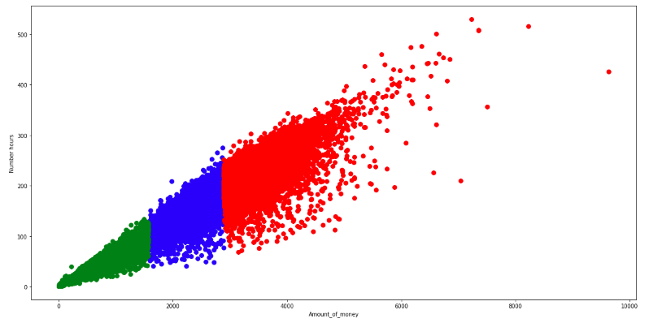
Part-time
Driver
(green)
Taxi Drivers
Clusters
K-means
Full time
Driver
(blue)
Workaholic
Driver
(red)

Slide 15
1
Introduction
2
Exploratory Analysis
Agenda
3
Open questions

Slide 16
Top 3 correlations
Fare amount
Top 3 correlations
Tip amount
97%
Total amount
49%
Total amount
92%
Trip distance
48%
Fare amount
89%
Trip time
42%
Trip distance

Slide 17
Competitor Analysis - Revenue
R^2=88.66%
Competitor Three
RMSE=2.48
Competitor One
Competitor Two
Decision
Tree
Regressor
Lasso
Ridge
Lineal
Predicting fare amount

Slide 18
Competitor Analysis - Revenue
Competitor One
Competitor Three
R^2 = 23.59
RMSE=1.40
Competitor Two
Linear
Regression
Ridge
Regression
Neural
Network
Lasso
Predicting tip amount

Slide 19
Maximize Earnings and minimize cost
Design and implement a fleet dispatch system (based on demand forecast) to schedule the supply of cars and drivers to:
Earn more trips by being closer to busiest locations and busiest times
10%
9 am
3 pm
0.0 am
6 pm
10 pm
Supply
Demand
3 pm

Slide 20
1
Introduction
2
Exploratory Analysis
Agenda
3
Open questions
4
Optional questions

Slide 21
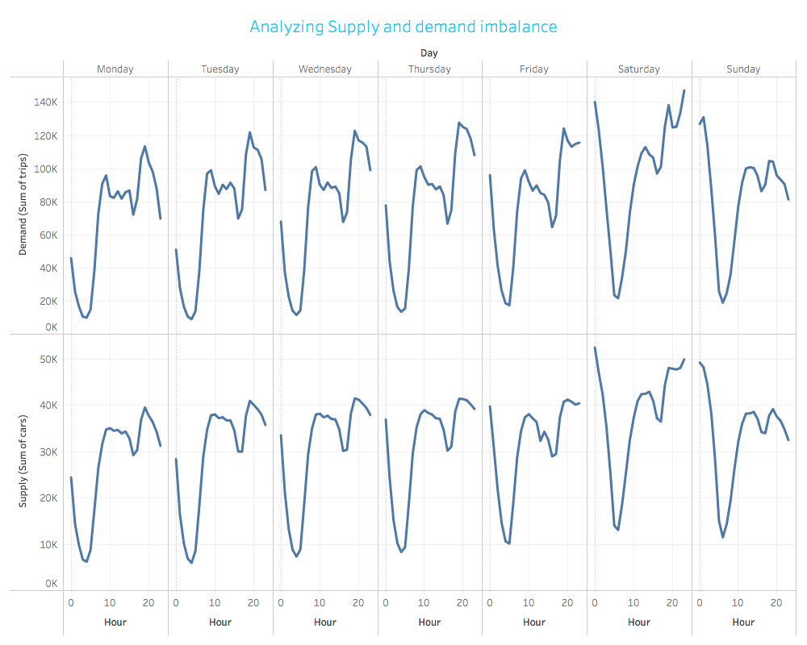

Slide 22
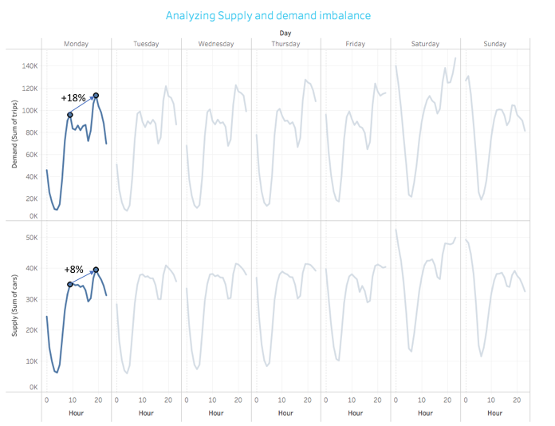

Slide 23
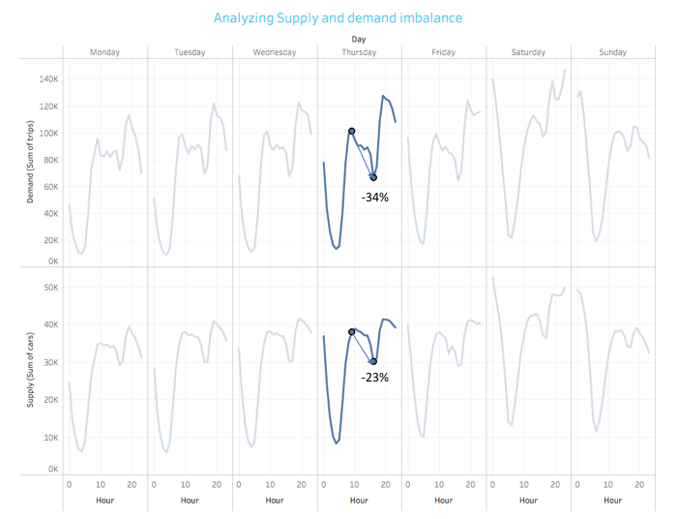

Slide 24
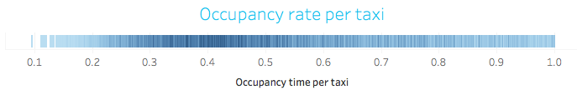
Maximize Earnings and minimize cost
Design and implement a fleet dispatch system (based on demand forecast) to schedule the supply of cars and drivers to:
Earn more trips by being closer to busiest locations and busiest times
Maximize the time that a car is occupied by passenger(s). Current % average time is 44%
Consider reduce assets (cars) and contract third party rental car services
10%
9 am
3 pm
0.0 am
6 pm
10 pm
Supply
Demand
3 pm

Slide 25
1
Possible outliers missed
For instance, drivers who worked too many hours
2
Lack of parameters optimization
Regularization regression and Neural Network
Potential drawbacks
3
Underestimate competence ride hailing services
Being closer to the busiest pickup location is more relevant
4
Data is too old
Uber changed the market
5
Toll costs are not considered in the analysis
It might be an opportunity to optimize the cost

Slide 26
1
Macroplanning
Schedule resources (staff, cars) based on monthly demand forecast. Multivariate LSTM approach considering new features.
2
Microplanning
Schedule resources (staff, cars) based on weakly demand forecast. Multivariate LSTM and multitasking approach based on pickup location
Pathway to improve
3
Macroplanning and Microplanning working together
Main goal: Optimize return on assets and boost profit
4
Generate alternative data to compete against ride hailing service
Predict the supply of cars per location by requesting fares in certain location
5
Demand forecasting needs to consider more features
Social media features, weather

Slide 27

Find the GitHub repository online
https://github.com/robeespi/NYC-taxi-2013-analysis-modeling-visualization

